Slide 1
Lecture 3: Measure of Dispersion
Jibo He, Ph.D.
Associate Professor
Wichita State University
jibo.he@Wichita.edu

Slide 2
Review from last lecture
Frequency table
Histogram
Frequency polygon
Bar graph / Pie graph
Measure of central tendency
Mode
Median
Mean

Slide 3
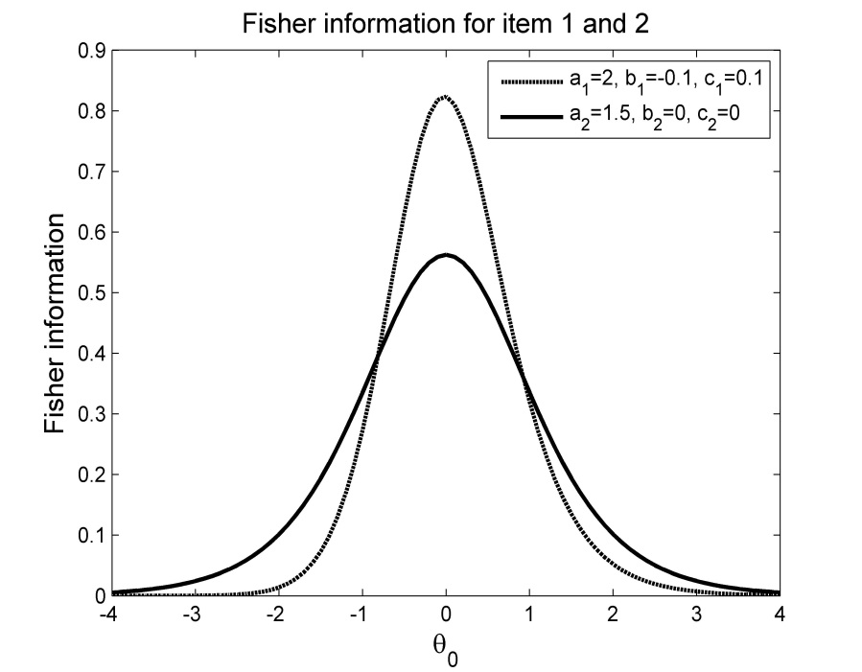
Frequency Distribution: Shape
Symmetric distribution
Mean=median=mode
Bi-modal distribution

Slide 4
Frequency Distribution: Shape
Bi-modal distribution

Slide 5
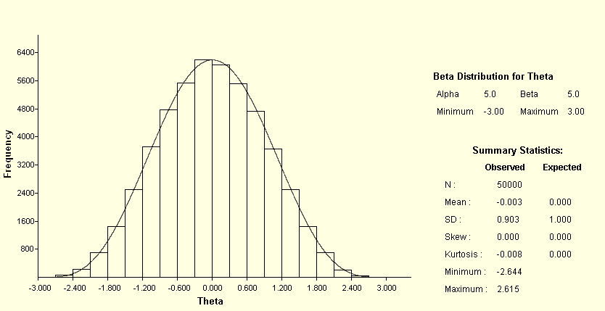

Frequency Distribution
Normal distribution

Slide 6
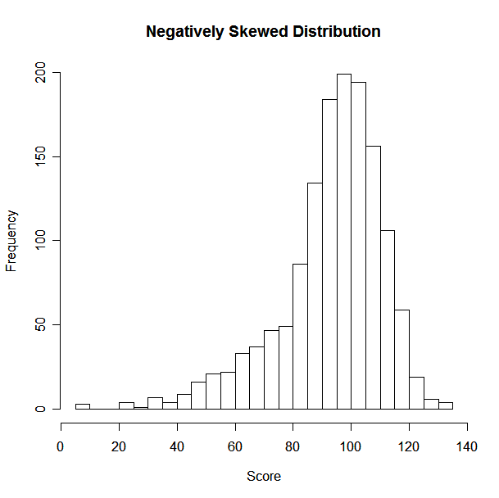
Frequency Distribution
Skew
Skew will be negative when the left tail is longer:
“Skewed to the left”

Slide 7
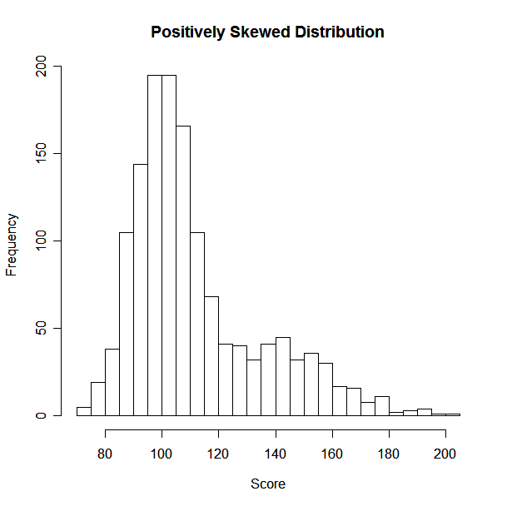
Frequency Distribution
Skew
Skew will be positive when the right tail is longer:
“Skewed to the right”
Notes:
kat4dhey

Slide 8
Measures of Dispersion: Range
Range
A simple statement of the highest and lowest scores in a distribution
Test scores 23-98
Incomes $15,000--$70,000
Temperature 62F-81F

Slide 9
Measures of Dispersion: Deviations
Deviations from the mean
The mean deviation
Indexes the degree to which scores in the sample differ with respect to the mean
Deviation scores:
Mean of the deviation scores:

Slide 10
Descriptive Statistics: Spread
Mean absolute deviation (MAD):
Sum of squares
The sum of the squared deviations of the scores about the mean is usually not zero, but it is smaller than the sum of the squared deviations about any other number.

Slide 11
Population Standard Deviation
Variance
Standard deviation

Slide 12
Sample Standard Deviation
Variance
Standard deviation
There are n-1 “degrees of freedom”
(If you know the mean and n-1 observations
then you can figure out the n’th observation)

